Slide 1
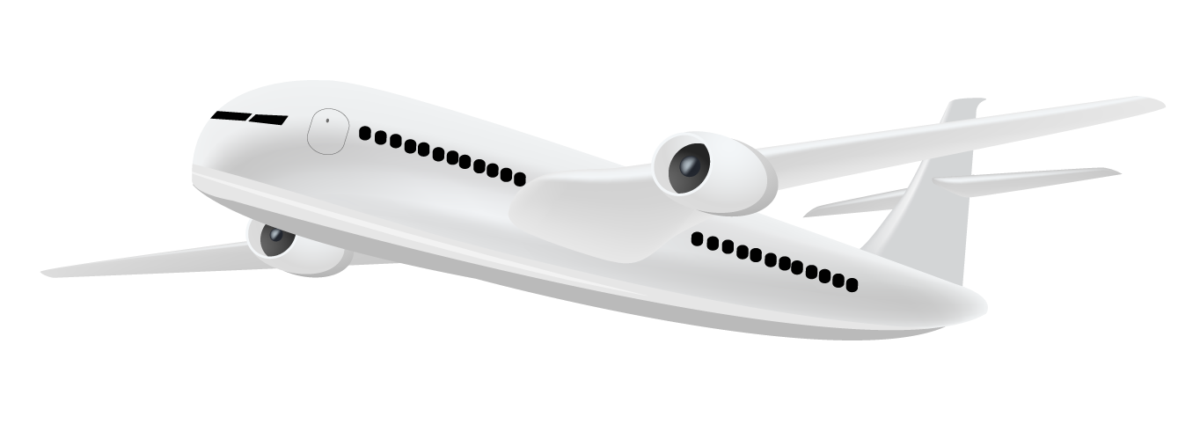




Domestic Flight Delays Prediction: Airline Delays Data
5
GROUP
Jack
Adi
Tony

Slide 2
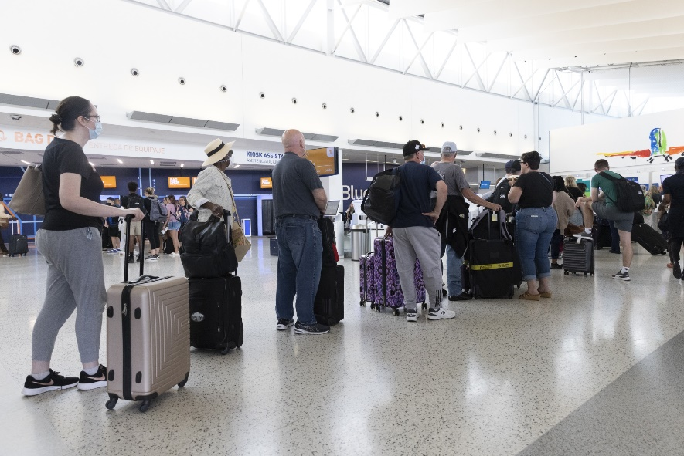
1,041,997
Number of delayed flights in 2022 (YTD)
Source: Bureau of Transportation Statistics
“…the desire to discover, the discover to move, and to connect with others are fundamentals to our existence as humans.”
Travelers at John F. Kennedy International Airport in New York on July 1, 2022.
Source: Angus Mordant/Bloomberg
Notes:
Background:
Flight delay has become a very important subject for air transportation all over the world because of the associated financial losses that the aviation industry experiences. These delays not only cause inconveniences to the passengers but also to the airlines. Due to the increased travel time, passengers are forced to spend more money on food and lodging, ultimately resulting in stress. Airlines face extra costs due to crew repositioning, fuel consumption while trying to reduce elapsed times, and a variety of other factors that could potentially reduce their reputation and lower passenger demand. These delays can be attributed to a variety of factors, including air congestion, poor weather conditions, mechanical problems, difficulties boarding passengers, and simply the airline's inability to handle the demand.
So, what can be done as a passenger to avoid delayed flights? is it possible to know if your flight will be delayed before it comes up on the departure boards? or before you being inside the plane? The answer to these questions is maybe. By using Machine Learning (ML) Algorithms you can try to predict if your flight will be delayed in many ways. And this is exactly what we have attempted to do in this project.

Slide 3

Table of Contents
01
02
03
04
05
Data Background
Data Preprocessing
Exploratory Data Analysis
About the Data.
Data Glossary. Data Balancing.
Feature Engineering. Data Interpretation.
Prediction Model
Concluding Notes
Logit Regression. Confusion Matrix. Random Forest Classifier.
Project Summary. Lessons Learned.
COMMERCIAL FLIGHT DELAYS PREDICTION
Intro to Data Science Group 5 Project
– page 3

Slide 4

01
Data Background
About the Data.
Snapshot of an Airport Schedule Status Board showing delayed flights.
Source: Matt Trommer/Park Sleep Fly
Notes:
The U.S Department of Transportation's (DOT) Bureau of Transportation Statistics tracks the on-time performance of domestic flights operated by large air carriers. Summary information on the number of on-time, delayed, canceled, and diverted flights is published in DOT’s monthly Air Travel Consumer Report. The particular dataset has been made available on Kaggle, which was the source of reference. The entire dataset consists of data ranging from the year 2009 till 2018. For the purpose of analysis, we’ll be picking up the dataset for 2015 only. The total observations in the dataset exceed 5 million rows and 35 different variables.

Slide 5

About the Data
What – 3 Datasets (Airlines, Airports, and Flights)
What – 5,819,079 Observations & 35 Variables
When – 2009 : : 2018 (2015)
Where – 322 Airports. 308 Cities. 50 States. US.
Why – For insights, and good grades!
Flight Delays as an “Unpredictable” Natural Part of Travel Life. Or should it?
Source: Jaromir Chabala/Shutterstock
COMMERCIAL FLIGHT DELAYS PREDICTION
Intro to Data Science Group 5 Project
– page 5
Notes:
The U.S Department of Transportation's (DOT) Bureau of Transportation Statistics tracks the on-time performance of domestic flights operated by large air carriers.
Summary information on the number of on-time, delayed, canceled, and diverted flights is published in DOT’s monthly Air Travel Consumer Report.
The particular dataset has been made available on Kaggle, which was the source of reference.
The entire dataset consists of data ranging from the year 2009 till 2018.
For the purpose of analysis, we’ll be picking up the dataset for 2015 only.
The total observations in the dataset exceed 5 million rows and 35 different variables.
For the sake of our analysis, we will only randomly select 581,908 rows which is 10% of the original dataset size.
Additionally, we used the airports and airlines dataset to map it into our dataset for EDA purpose.

Slide 6
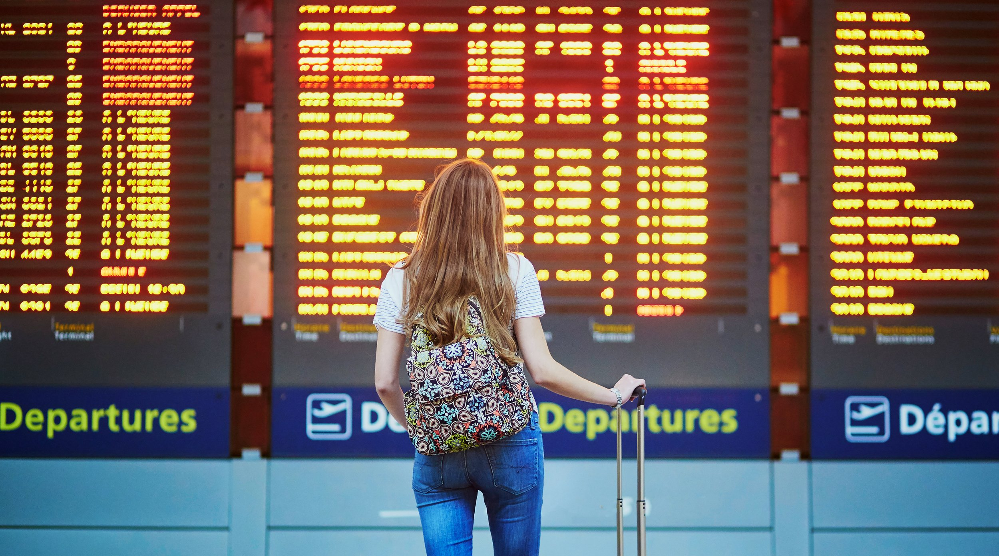
02
Data Preprocessing
Diving into the Data
Passengers routinely experience flight delays at several U.S. airports due to storms or other weather conditions.
Source: James Carter / Getty Images
Notes:
The U.S Department of Transportation's (DOT) Bureau of Transportation Statistics tracks the on-time performance of domestic flights operated by large air carriers. Summary information on the number of on-time, delayed, canceled, and diverted flights is published in DOT’s monthly Air Travel Consumer Report. The particular dataset has been made available on Kaggle, which was the source of reference. The entire dataset consists of data ranging from the year 2009 till 2018. For the purpose of analysis, we’ll be picking up the dataset for 2015 only. The total observations in the dataset exceed 5 million rows and 35 different variables.

Slide 7
Data Glossary
DEP_DELAY = Total Delay on Departure in minutes
TAXI_OUT = The time duration elapsed between departure from the origin airport gate and wheels off
WHEELS_OFF = The time point that the aircraft's wheels leave the ground
WHEELS_ON = The time point that the aircraft's wheels touch on the ground
TAXI_IN = The time duration elapsed between wheels-on and gate arrival at the destination airport
ARR_TIME = Actual Arrival Time = ARRIVAL_TIME - SCHEDULED_ARRIVAL
CANCELLATION_CODE = Reason for Cancellation: A - Airline/Carrier; B - Weather; C - National Air System; D - Security
DIVERTED = Aircraft landed on different airport that the one scheduled
CRS_ELAPSED_TIME = Planned time amount needed for the flight trip
ACTUAL_ELAPSED_TIME = AIR_TIME+TAXI_IN+TAXI_OUT
FL_DATE = Date of the Flight
OP_CARRIER = Airline Identifier
ORIGIN = Starting Airport Code
DEST = Destination Airport Code
CRS_DEP_TIME = Planned Departure Time
DEP_TIME = Actual Departure Time
ARR_DELAY = Total Delay on Arrival in minutes
CANCELLED = Flight Cancelled (1 = cancelled)
AIR_TIME = The time duration between wheels off and wheels on time
DISTANCE = Distance between two airports
CARRIER_DELAY = Delay caused by the airline in minutes
WEATHER_DELAY = Delay caused by weather
NAS_DELAY = Delay caused by air system
SECURITY_DELAY = caused by security reasons
LATE_AIRCRAFT_DELAY = Delay caused by security
COMMERCIAL FLIGHT DELAYS PREDICTION
Intro to Data Science Group 5 Project
– page 7
Notes:
I know this slide may look crammed up, but its an important one to look at. It provides us of all the available features in our dataset.
It was important to study each feature and map it with the objective of our problem. A lot of pre-processing has been done on these columns as well.
First what we did was decide on a response variable. We defined what delay meant. There are two columns that give information on delay – departure_delay and arrival_delay. So as a starting point, Only flights that arrived late to their destination were considered as delay. With this column we created a target variable. If arrival delay > 0 then 1 otherwise 0. There are two other interesting columns, cancelled and diverted which are self explanatory. A cancelled flight is not a delayed flight and when we subsetted to diverted flights, arr_delay was all nulls. So to proceed further, we subsetted our dataset to include only non-cancelled and non-diverted flight. That resulting in dropping cancellation code column as well. 4 other interesting column which delay reason, we thought we'd get interesting results from it but 90% of them were nulls so we just dropped them too.
To reiterate the objective, this project aims to build a predictive model on possible Flight delay given a set of features. What adds value to this project is the ability to predict this prior to the Flight has been announced as delay. If a passenger already sees their flight as delayed and we predict to him that it is going to be delayed, then the value drops. Therefore, we were to only keep the variables that you as a passenger are aware of before the planes takes off from its origin airport. The identified variables that were not to be considered are: Taxi_Out, Wheels off and on, Taxi_in, Actual elapsed time, and air time as we can understand from their definitions that they cannot be known before hand. To demonstrate this as well, we've built models with and without them and we see how the predictive power goes up.
You will notice that departure_delay is not a part of this list. We too had the normal assumption that if there is departure delay, then it goes to say there will be arrival delay as well. But we decided not to jump to conclusion and let the data speak for itself.

Slide 8
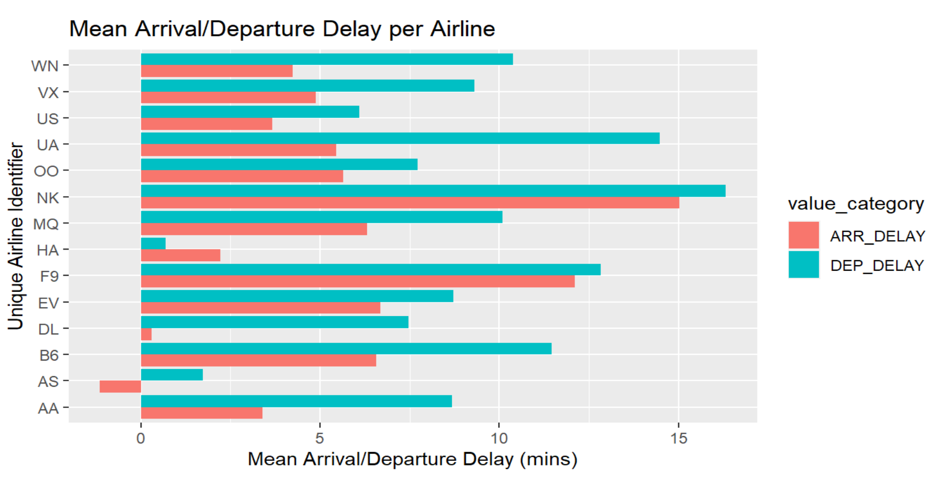
COMMERCIAL FLIGHT DELAYS PREDICTION
Intro to Data Science Group 5 Project
– page 8
Notes:
We plotted the average departure delay, and average arrival delay per airline in our dataset, and we found this! Which was an extremely interesting observation. Most airlines have a higher average departure delay but a lower average arrival delay. Seems like, every airline attempts to put in effort to account for its departure delay by reducing elapse time, which may lead to higher fuel consumption and additional costs for the airline.
Alaska Airline actually has a negative arrival time which indicates they arrive earlier than usual!
However, we still don't go ahead and use this feature in our models because it still contradicts our value addition.

Slide 9
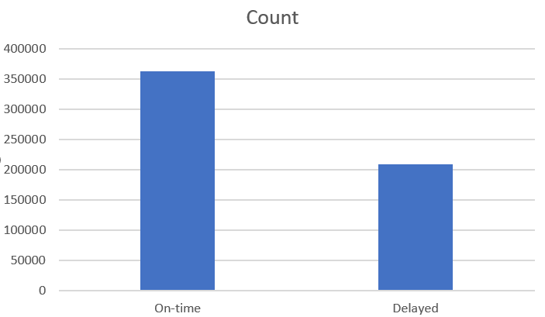
Data Balance
COMMERCIAL FLIGHT DELAYS PREDICTION
Intro to Data Science Group 5 Project
– page 9
Notes:
Next, we plotted the data balance of the response variable.
Now to answer one of the SMART questions, since there is slight skewness, almost half, between the predicted variable, accuracy will not be enough as a criteria to judge our model. Precision and recall will play an important role as well.
However, as the business problem is predicting whether a flight is delayed or not, it is more important to catch all flights that are actually delayed as opposed to optimizing whether a predicted delay is correct or not.
We decided that there is no harm in proactively anticipating and preparing for flights that have anticipated delayed and they turn out to be not delayed. However, there is greater business loss if we miss out on flights that delayed but we were not able to identify them.
In technical terms, our models need to be tuned to have a higher **recall** as opposed to **precision**.

Slide 10
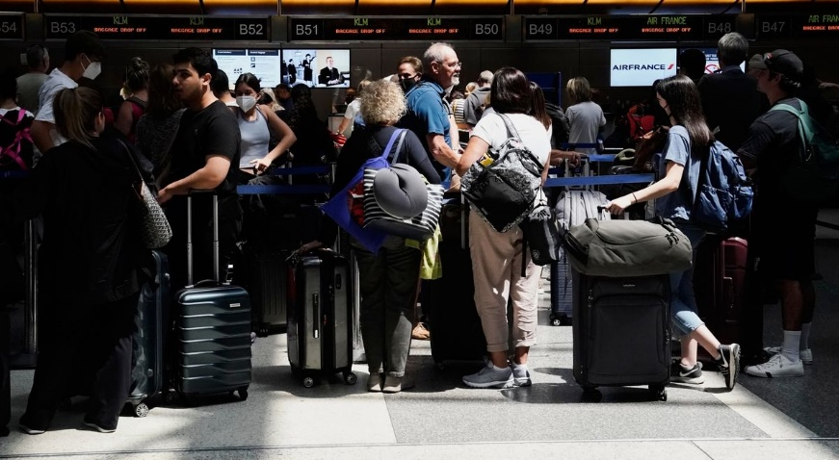
03
Exploratory Data Analysis
Visuals to quench our curiosity.
A world without long queues and outrageous wait times? One without airport sleepovers and missed schedules?
Source: Bing Guan/Bloomberg

Slide 11
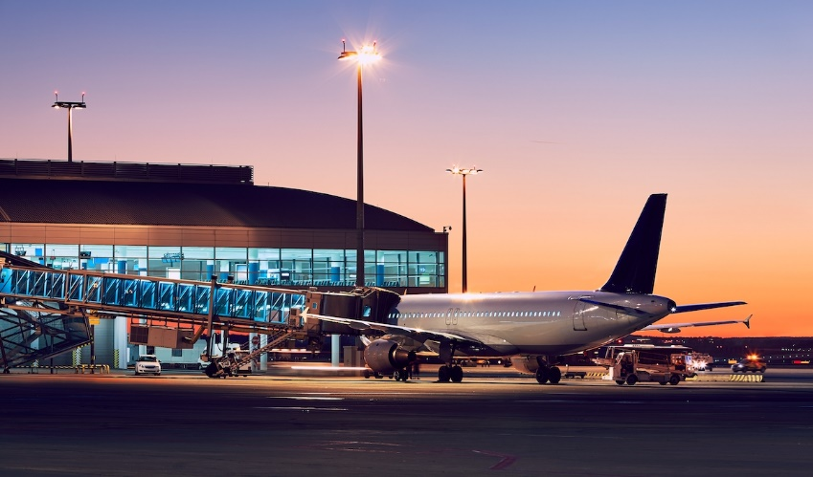
Feature Engineering
Month – Extracted from Date
Day of the Week – Extracted from Date
Hour – Extracted from scheduled departure time
Outdated Airport Terminals, Bad Weather, and Poor Schedule Management are leading causes of air travel delay worldwide.
Source: Patrick Lucas/ACI Insights
COMMERCIAL FLIGHT DELAYS PREDICTION
Intro to Data Science Group 5 Project
– page 11
Notes:
Before we jumped into EDA, we created a few more variables to aid our EDA and modeling.

Slide 12
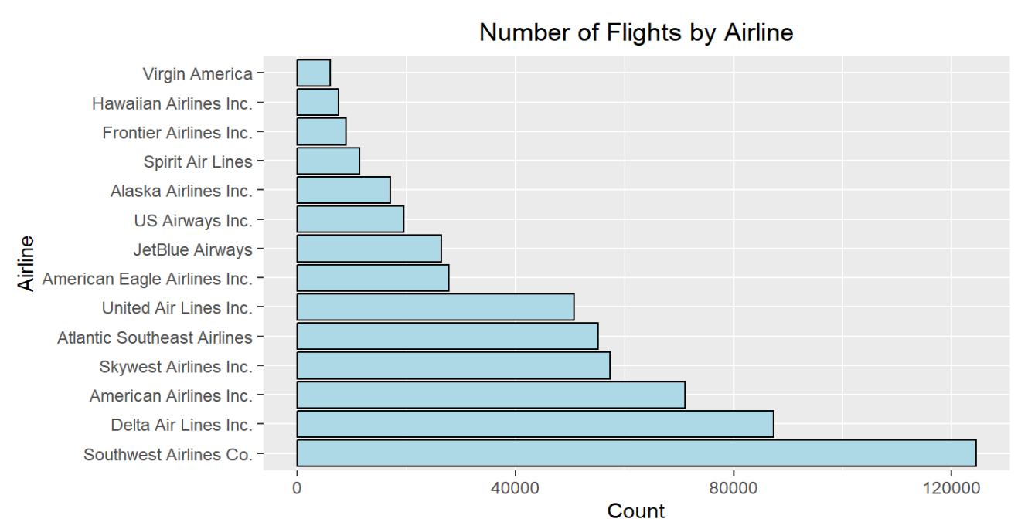
Exploratory Data Analysis
1A. Looking at Airlines Quality in terms of Delay
COMMERCIAL FLIGHT DELAYS PREDICTION
Intro to Data Science Group 5 Project
– page 12
Notes:
There are 14 airlines in our dataset. We first plotted the total number of flights per airline.
This is quite an interesting plot to start with as it already tells us which are the airlines that have the most domestic flights in the US:
1. Southwest Airlines
2. Delta Airlines
3. American Airlines
4. SkyWest Airlines
5. Atlantic South East Airlines
Now the question to ask ourselves would be: if the top 5 airlines in terms of number of flight, are also the best in terms of arriving on time? We'll see which are the airlines with the most delayed flight to try to answer this:

Slide 13
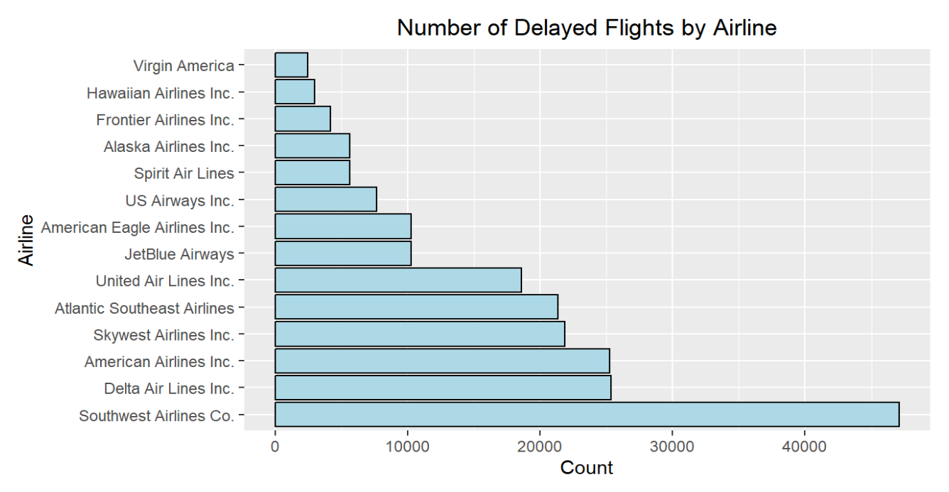
Exploratory Data Analysis
COMMERCIAL FLIGHT DELAYS PREDICTION
Intro to Data Science Group 5 Project
– page 13
Notes:
Next we plotted the number of delays per airline.
It seemed like the top 5 airlines with most flights also had the most number of delays.
This was not a fair analysis.
It was a better idea to see the percentage of flights or proportion of flights that were delayed per airline to gauge the performance of airlines.
Before doing that, we also set up a threshold. We created an average delay percentage across all airlines and found that to be 36.51% for the year 2015. Which essentially means that roughly 1 out of every 3 flight was delayed.

Slide 14
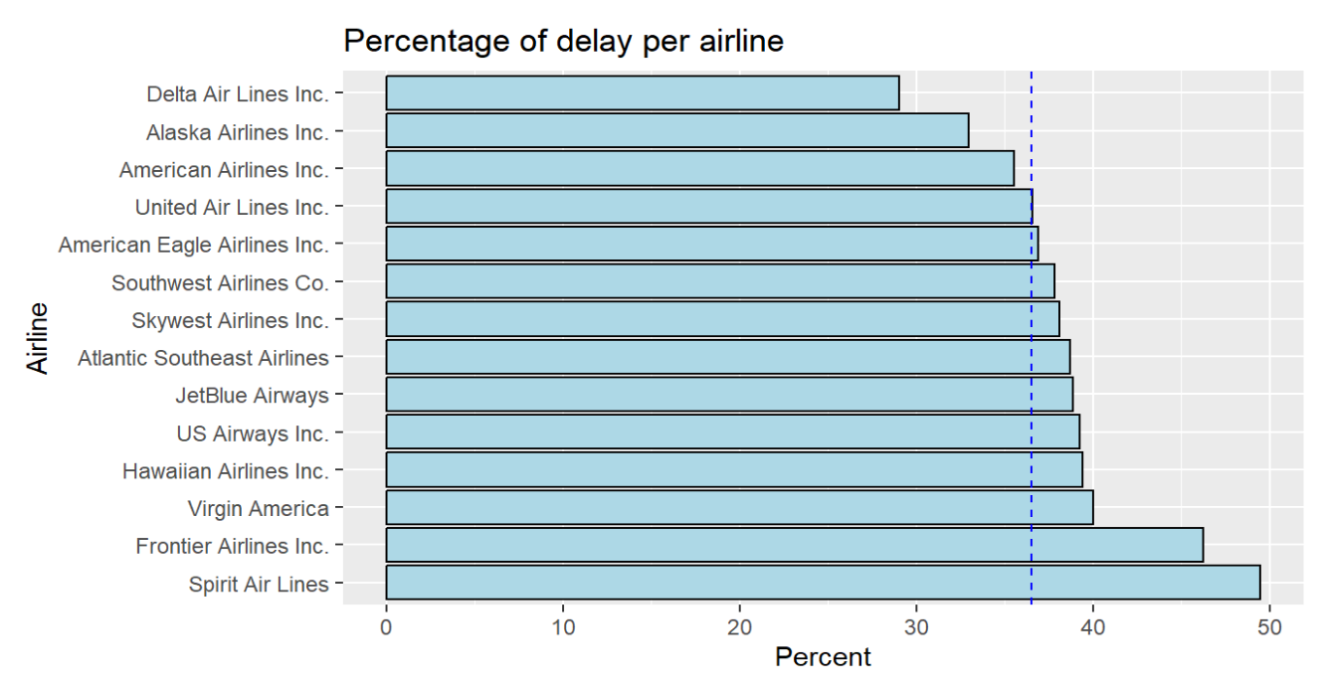
Exploratory Data Analysis
COMMERCIAL FLIGHT DELAYS PREDICTION
Intro to Data Science Group 5 Project
– page 14
Notes:
This is the plot. This is provides us with really interesting observations.
Delta Airlines is the second airline with the highest number of flights, at the same time is again the second highest number of delayed flights, but in terms of percentage of delayed flights, it is the airline with the best percentage at 29.02%. That represents ~7% below the threshold.
American Airlines in another airline that tops the list in terms of number of flights but is still below the threshold value in terms of delay.
So these two airlines must be the most sought after by passengers if they want to avoid delay.
Southwest Airlines has the most flights and consequently, a higher number of delayed flights as well, but as our last plot suggests, it is not the worst, it is the sixth best and is above the threshold value by over 1%, so definitely not great compared to Delta Airlines. Similarly Atlantic SouthEast Airlines and United airlines have large number of flights but perform somewhat moderately when compared to other airlines.
Now coming to the bad airlines. The top 4 airlines with the highest percent of delays happen to be the top 4 airlines with the least number of flights as well. These airlines should definitely be avoided by passengers if they want to ensure timely arrival.

Slide 15
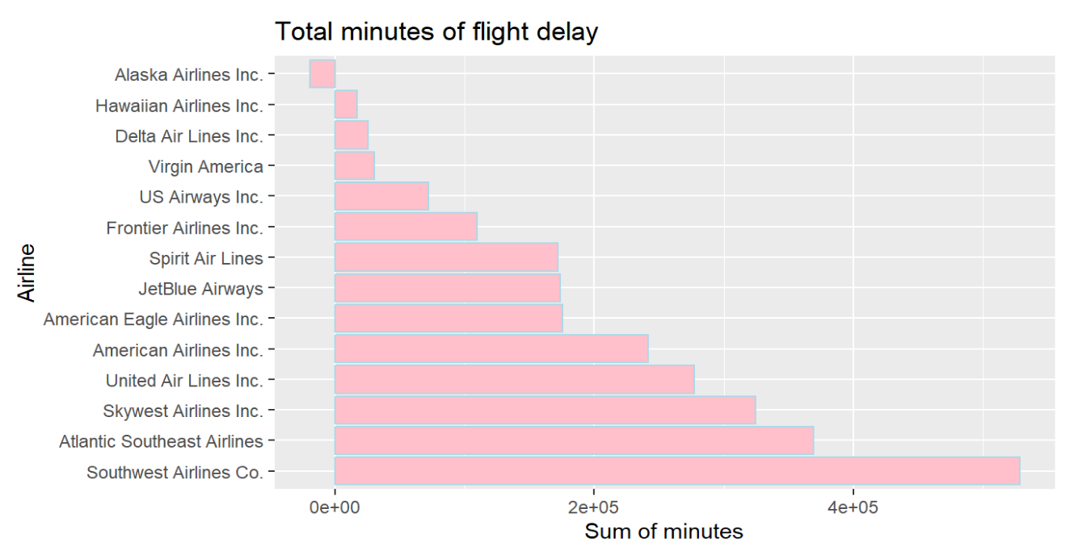
Exploratory Data Analysis
COMMERCIAL FLIGHT DELAYS PREDICTION
Intro to Data Science Group 5 Project
– page 15
Notes:
Further airline quality testing found interesting results. We plotted the total number of minutes in flight arrival delay per airline.
With the help of this plot, we see that Southwest Airlines has the highest flight delays in number of minutes. So a passenger flying this airline can expect to extremely high delays (in minutes) in their travel.
Delta airline seems to do well here as well, being the 3rd highest in total delay duration, continuing to catch our attention!
Another airline that comes into notice with this plot is the Alaska Airlines. The negative bar plot indicates that they are prone to actually arriving earlier than usual by a larger margin than their flights get delayed! Which is good news for the passengers, most of the times.

Slide 16
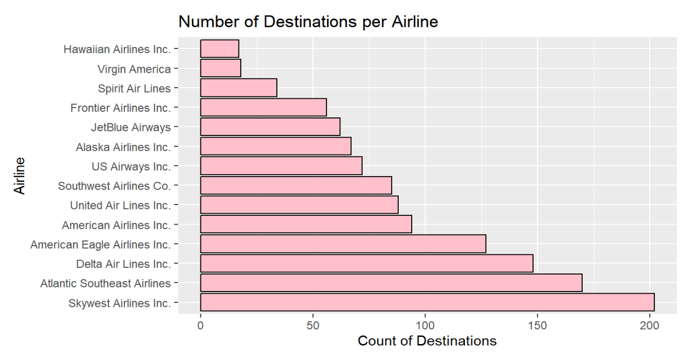
Exploratory Data Analysis
1B. Looking at Airlines Quality in terms of 'Coverage'
COMMERCIAL FLIGHT DELAYS PREDICTION
Intro to Data Science Group 5 Project
– page 16
Notes:
Lastly, we also plotted the total number of destinations (cities) per airline.
Delta airline continues to catch our attention with a lot of coverage. Whereas Southwest airline, despite being leader in number of flights, has only moderate coverage.
Verdict is that Delta airlines have a lot of coverage and minimum delay. But if you want to arrive earlier than usual, choose Alaska airlines.

Slide 17
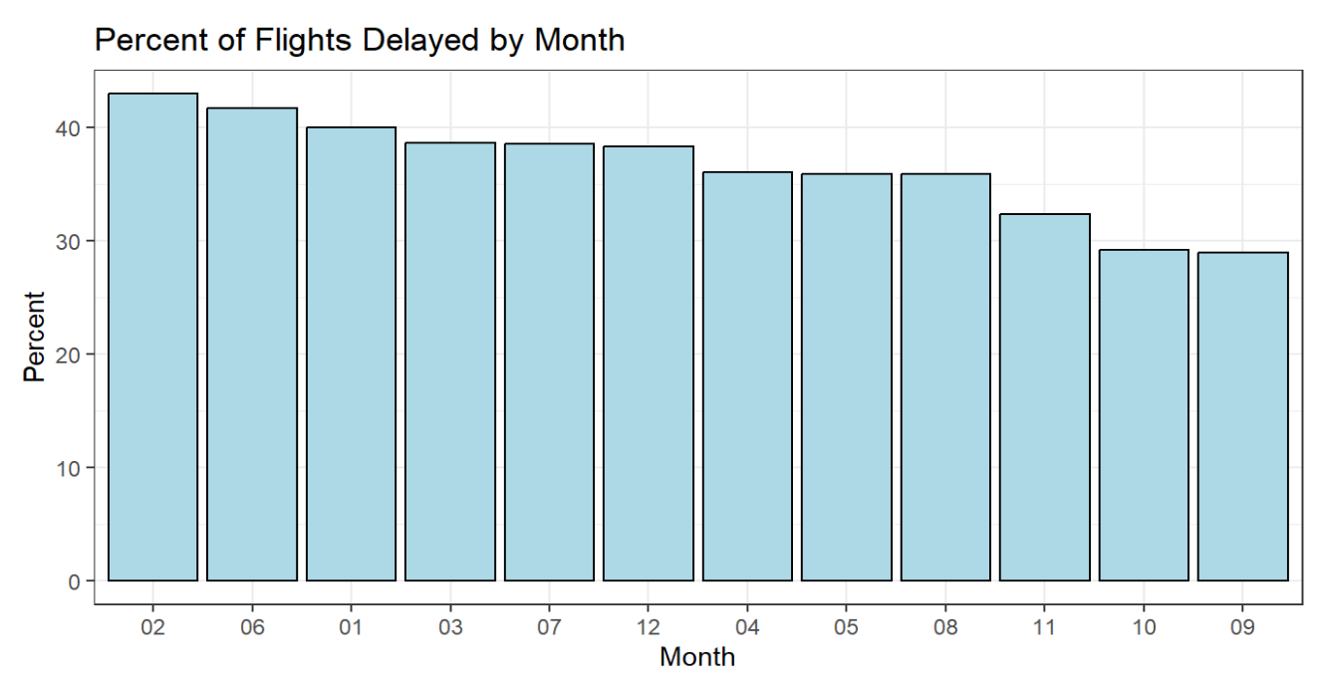
Exploratory Data Analysis
2. Best and Worst Months to travel, proportions
COMMERCIAL FLIGHT DELAYS PREDICTION
Intro to Data Science Group 5 Project
– page 17
Notes:
Seems like September is the best month to travel with the lowest proportionate delays. And February is the worst month to travel.

Slide 18
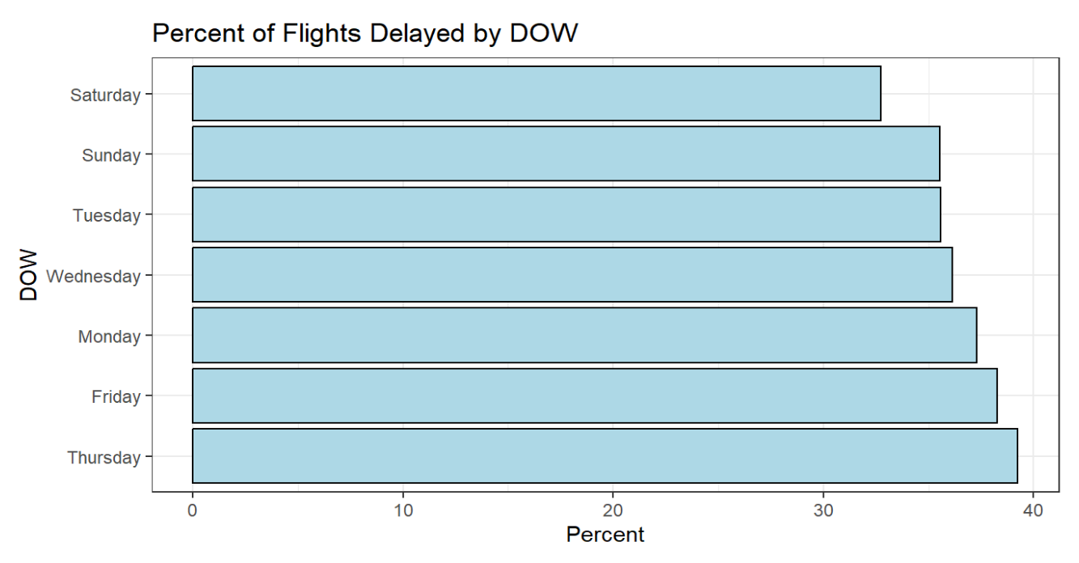
Exploratory Data Analysis
3. Best and Worst Day of the Week to travel, proportions
COMMERCIAL FLIGHT DELAYS PREDICTION
Intro to Data Science Group 5 Project
– page 18
Notes:
Here the best day of the week to travel is Saturday and worst is Thursday.
Next we'll look at the top 20 most travelled destinations. If I told you that New York is the city with the highest average arrival delay, it would make sense since its such a popular city. However, lets look at the top 20 busiest cities next.

Slide 19
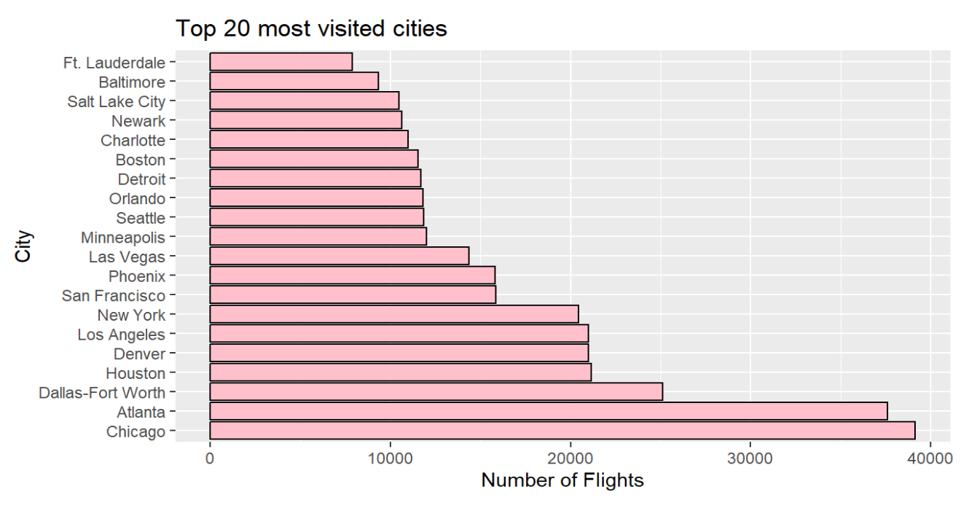
Exploratory Data Analysis
4A. Top 20 busy cities (destinations) in 2015.
COMMERCIAL FLIGHT DELAYS PREDICTION
Intro to Data Science Group 5 Project
– page 19
Notes:
Seems like New York is only 7th most busy. However, it still has the highest arrival delay. There must be something going wrong at its airports. Chicago tops the list. Now lets also add another dimension to this graph, on the average arrival delay per city.

Slide 20
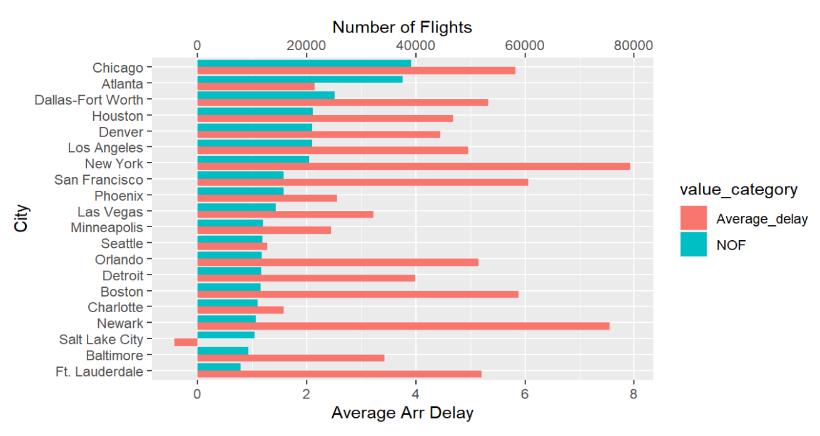
Exploratory Data Analysis
4B. Top 20 busy cities in 2015 and their arrival delays (averaged)
COMMERCIAL FLIGHT DELAYS PREDICTION
Intro to Data Science Group 5 Project
– page 20
Notes:
This graph gives us lots of useful information about the top 20 most visited cities. It is interesting to see how Atlanta, having such a high number of landings, has a very low average delay with just over 2 minutes, whereas Newark, a not so popular destination, has such a high minute average delay.
New York, which is the 7th most popular destination has the highest average delay out of all, which doesn't add up with it being the 7th most visited place. San Francisco is another destination that stands out with a high average delay as well as Orlando and Boston.
But there is also a city where flights usually on average arrive earlier than scheduled - Salt Lake City is famous for its early arriving flight.

Slide 21
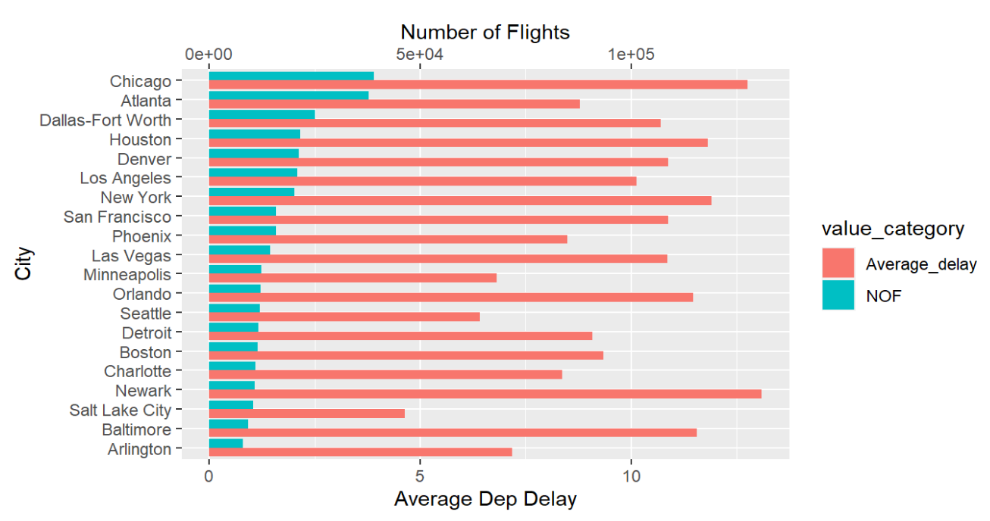
Exploratory Data Analysis
5. Top 20 busy cities in 2015 (origins) and their departure delays (averaged)
COMMERCIAL FLIGHT DELAYS PREDICTION
Intro to Data Science Group 5 Project
– page 21
Notes:
Then we repeated the same thing for top 20 origin cities and associated departure delays with them. It seems like all cities have a high average departure delay. This is because either the flights leave on time corresponding to 0 departure delay or have a slight departure delay of a couple of minutes.
Salt Lake City stands out here as well, having the lowest average departure delay of just under 5 minutes.

Slide 22
04
Prediction Model
Predicting these delays.
A world without long queues and outrageous wait times? One without airport sleepovers and missed schedules?
Source: Bing Guan/Bloomberg

Slide 23
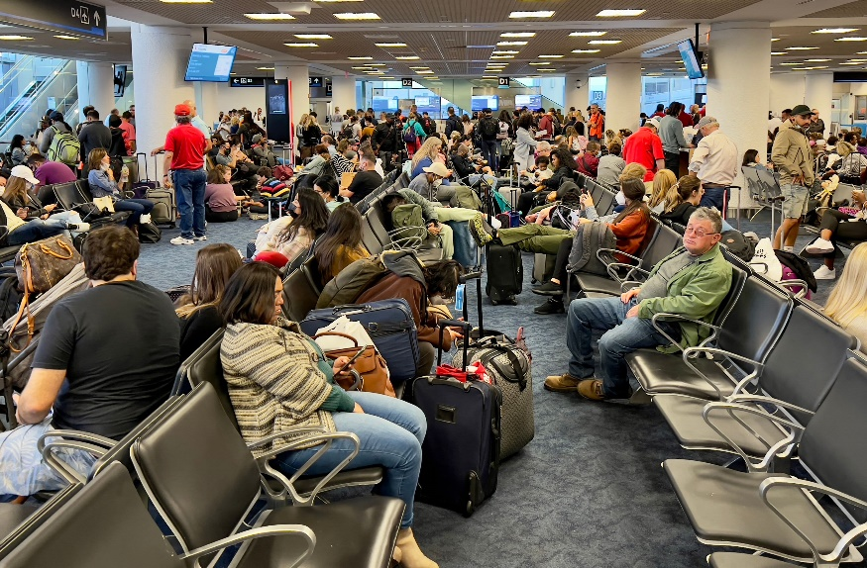
Logistic Regression
Began with Logistic Regression on a training set of >22,000 observations.
Used the Following Predictors:
Airline
Airport Origin
Airport Destination
Month
Day of Week
Time of scheduled takeoff (by hour)
Distance of flight
We wanted to use predictors that could be used before the flight was scheduled.
Travelers delayed at Miami International Airport in Miami, Florida, on April 22, 2022.
Source: Daniel Slim/Getty Images
COMMERCIAL FLIGHT DELAYS PREDICTION
Intro to Data Science Group 5 Project
– page 23

Slide 24
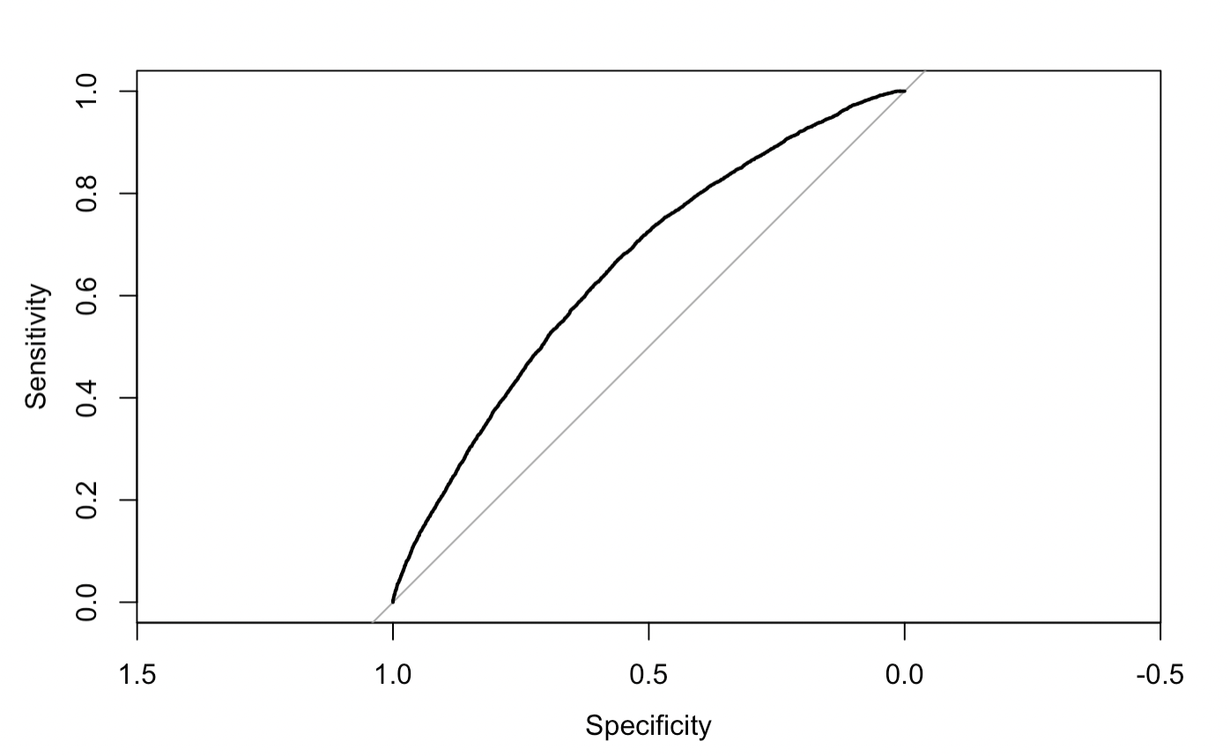
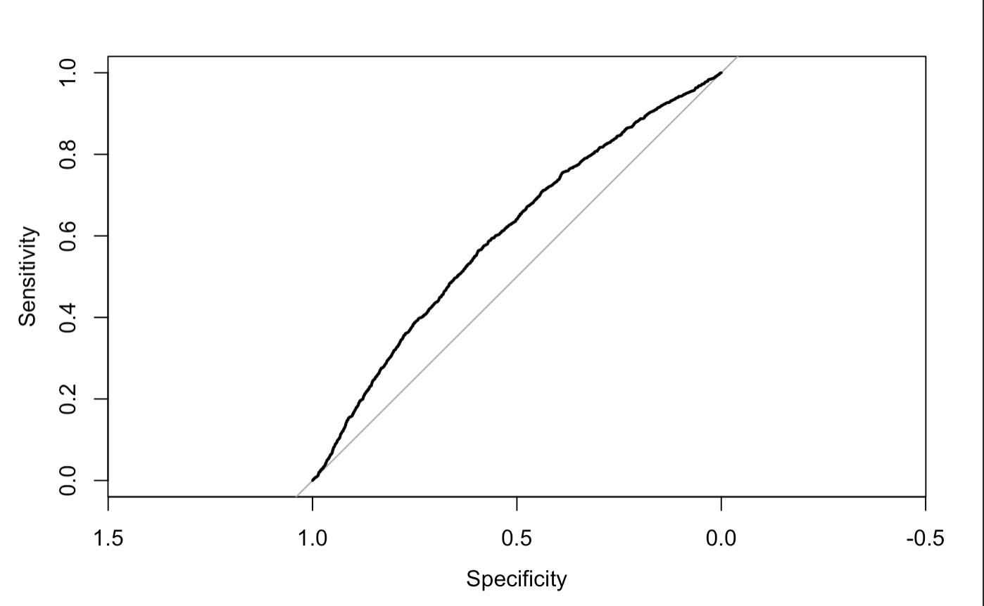
Logit Results
ROC Curve on Training Dataset
AUC: 0.654
McFadden: 0.058
AIC: 29496
ROC Curve on Testing Dataset
AUC: 0.600
COMMERCIAL FLIGHT DELAYS PREDICTION
Intro to Data Science Group 5 Project
– page 24

Slide 25
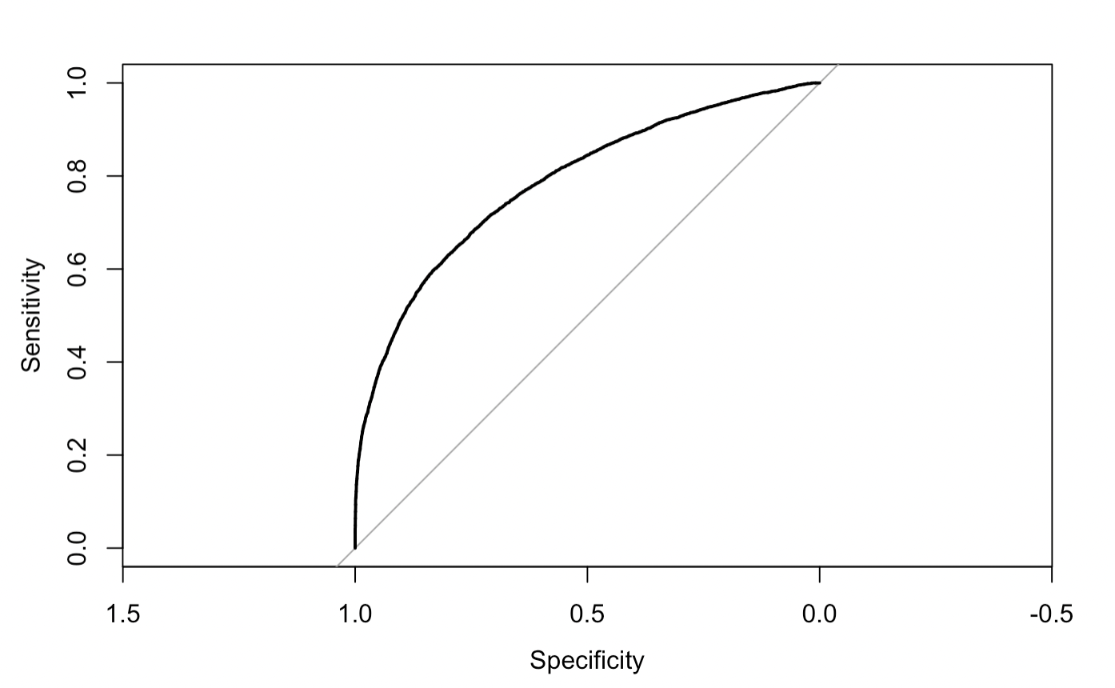
Logit Results – Highly Predictive Variables
Adding variables that are collected after or during the flight, such as taxi time, actual flight duration, and arrival time.
These are obviously going to correlate with delays, so they were not included in the final model.
Shown here for reference.
ROC Curve
AUC: 0.786
McFadden: 0.2063
COMMERCIAL FLIGHT DELAYS PREDICTION
Intro to Data Science Group 5 Project
– page 25

Slide 26
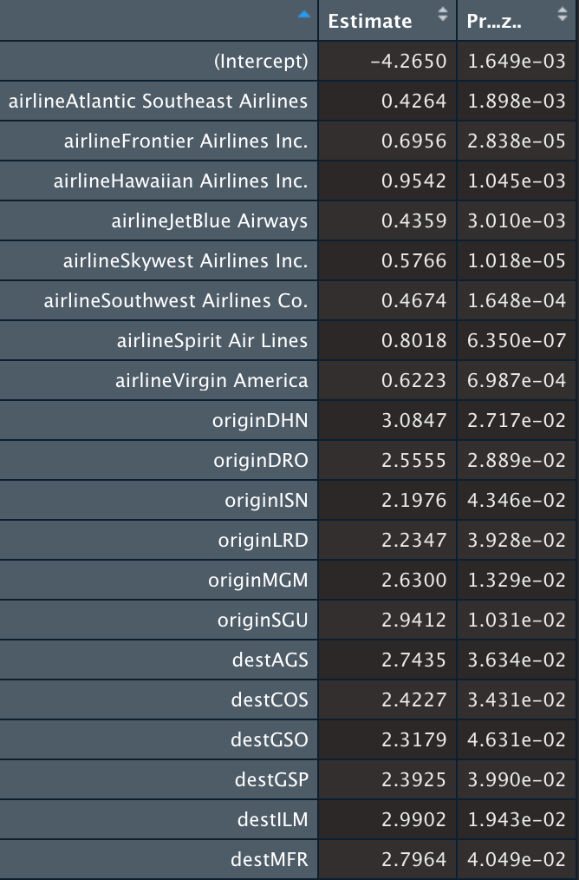
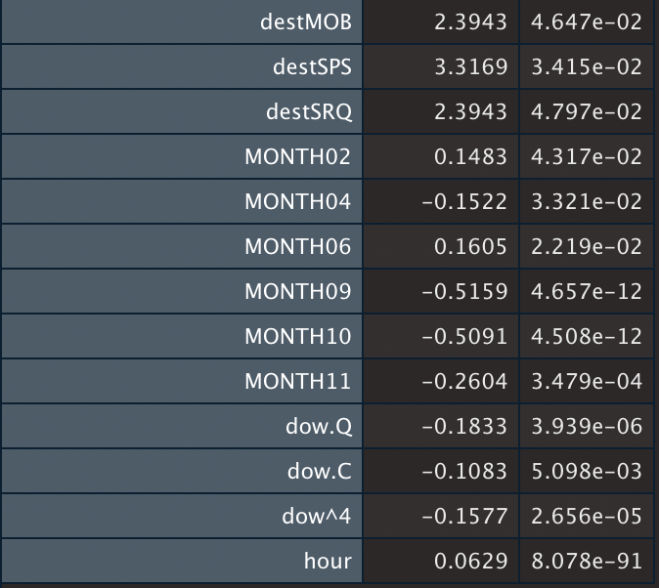
Significant Predictors
Over 400 coefficients, mostly due to so many different origin and destination airports.
COMMERCIAL FLIGHT DELAYS PREDICTION
Intro to Data Science Group 5 Project
– page 26

Slide 27
Confusion Matrix (CM)
Confusion Matrix at a 0.5 cutoff had the following metrics:
Accuracy: 62.9%
Recall: 19.1%
Specificity: 88.57%
Precision: 49.5%
Actual
 | On Time | Delayed
On Time | 3240 | 1732
Delayed | 418 | 409
Predicted
COMMERCIAL FLIGHT DELAYS PREDICTION
Intro to Data Science Group 5 Project
– page 27

Slide 28
CM with Different Cutoff Values
Confusion Matrix at a 0.4 cutoff had the following metrics:
Accuracy: 59.8%
Recall: 45.5%
Specificity: 68.2%
Confusion Matrix at a 0.35 cutoff had the following metrics:
Accuracy: 56.1%
Recall: 61.8%
Specificity: 52.8%
Actual
Actual
 | On Time | Delayed
On Time | 2494 | 1166
Delayed | 1164 | 975
 | On Time | Delayed
On Time | 1932 | 817
Delayed | 1726 | 1324
Predicted
Predicted
COMMERCIAL FLIGHT DELAYS PREDICTION
Intro to Data Science Group 5 Project
– page 28

Slide 29
Random Forest Classifier
Also used a Random Forest Classifier to see if we could improve our metrics.
Had to use a smaller dataset due to computational limits.
Could not use origin or destination airports because it was too large of a categorical variable.
Tried tweaking number of trees, depth of trees, size of nodes, etc. to improve accuracy and recall without much luck.
Confusion Matrix had the following metrics:
Accuracy: 57.8%
Recall: 27.4%
Specificity: 75.0%
Actual
 | On Time | Delayed
On Time | 543 | 297
Delayed | 181 | 112
Predicted
COMMERCIAL FLIGHT DELAYS PREDICTION
Intro to Data Science Group 5 Project
– page 29

Slide 30

Notes On Data Limitations
Scopes of improvement:
Weather Data
Airline Staffing Data
Data on International Flights
Airport Security Data
If we had this information available, our models would have likely improved.
We might need to wait for more data before we can design a brave new world for air travel.
Source: Capt Joe DePete / Twitter

Slide 31
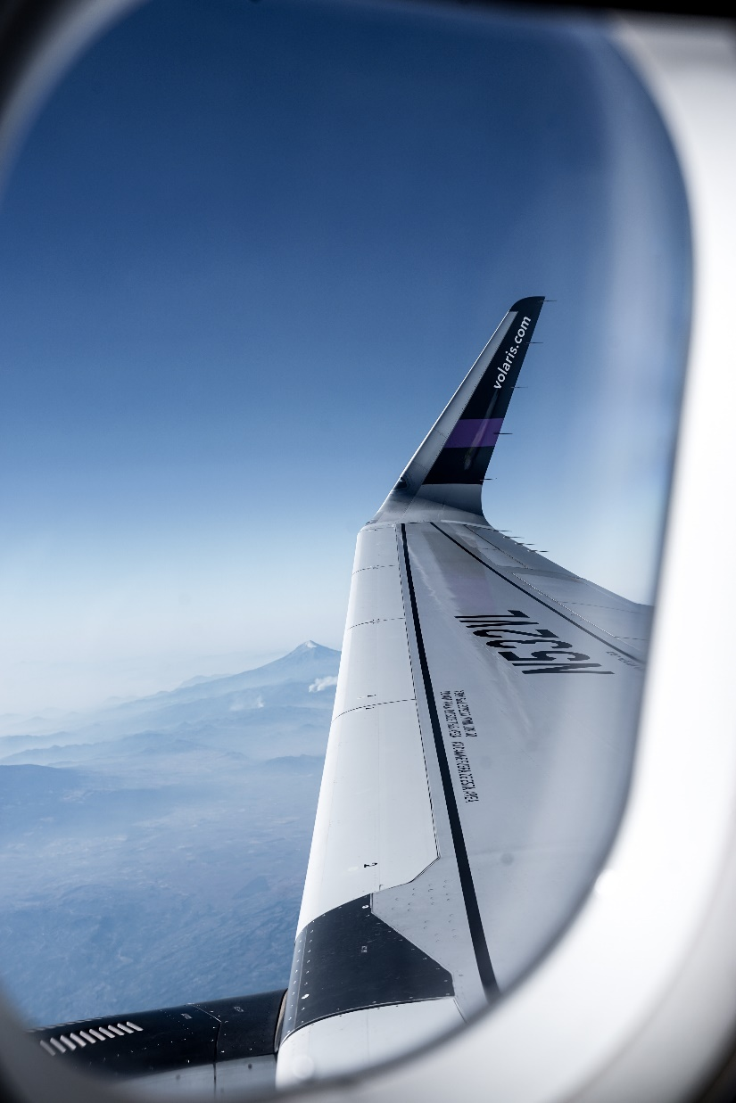
Summary
In summary, the key lessons learnt from the dataset used in the project were:
Certain Airlines and Airports are more likely to have delays than others.
As the day progresses, delays are more likely to occur.
The average delay percentage of domestic flights have dropped from 36.51% in 2015 to 20.19% in 2022 (YTD).
Flight delays are difficult to predict! Combining with more data would have been helpful.
While more dataset would have provided more insight, higher computational power is required to develop better models!
Your wings already exist, all you have to do is fly.

Slide 32
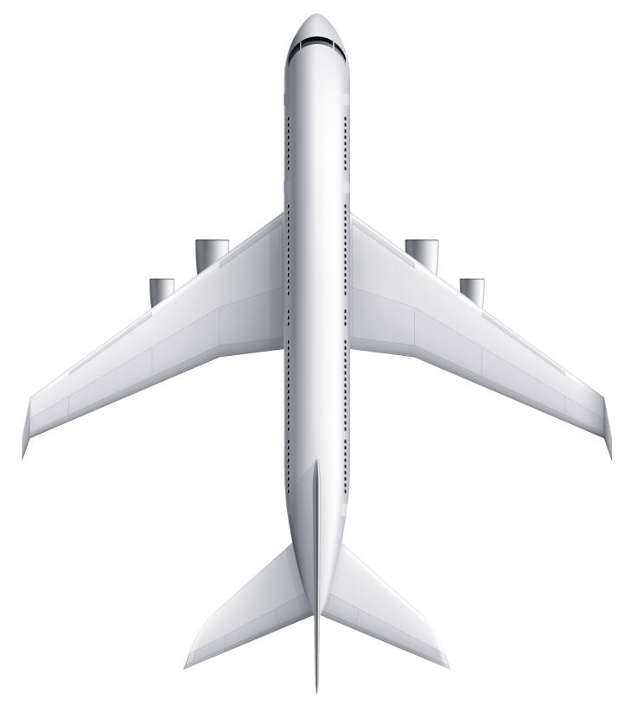
Thanks!
For more information
If you would like to learn more about our project, please reach out to any of the team members below:
Jack McMorrow
Data Scientist
jmcmorrow@gwmail.gwu.edu
Aditya Kumar
Data Architect
aditya_kumar@gwu.edu
Anthony C. Okoye
Information Designer
anthonycokoye@gwu.edu

